Slide 1
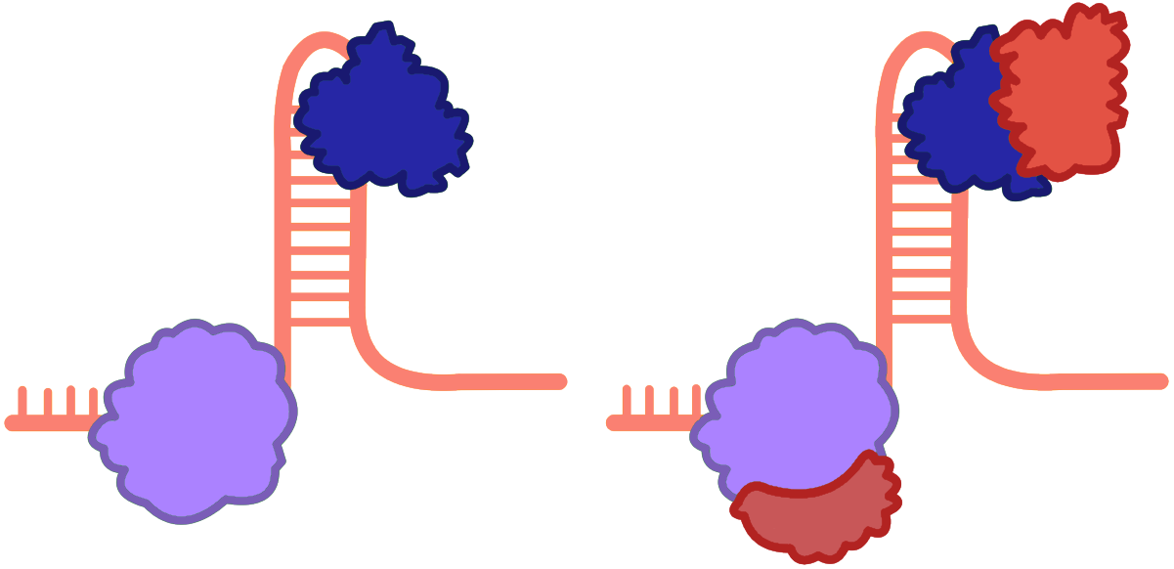
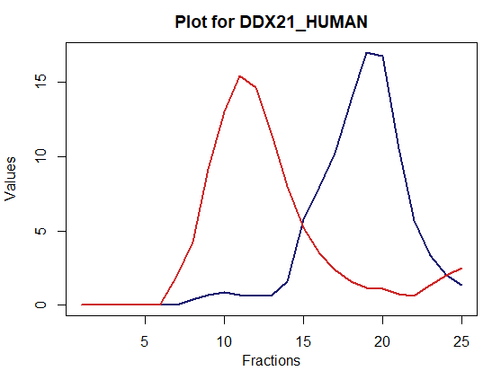
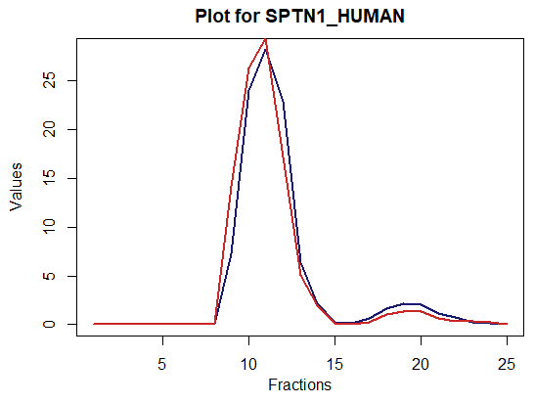
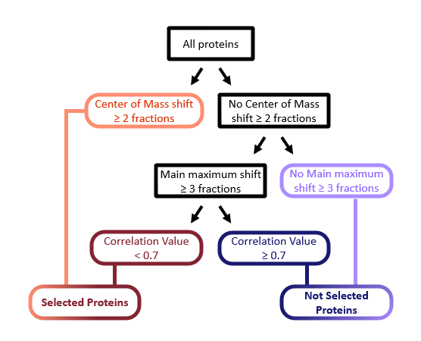
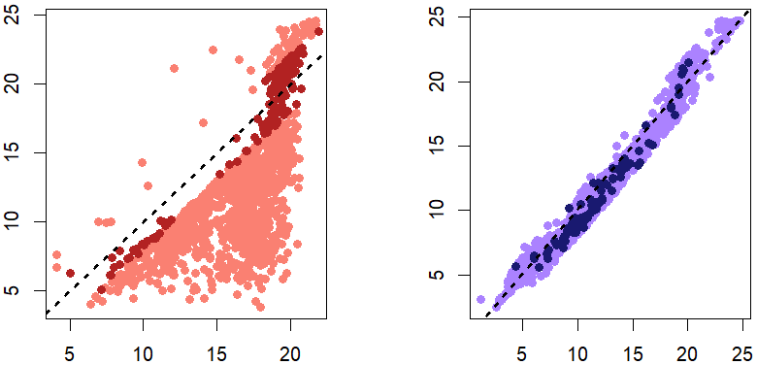
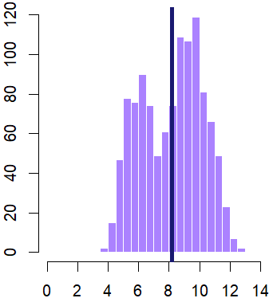
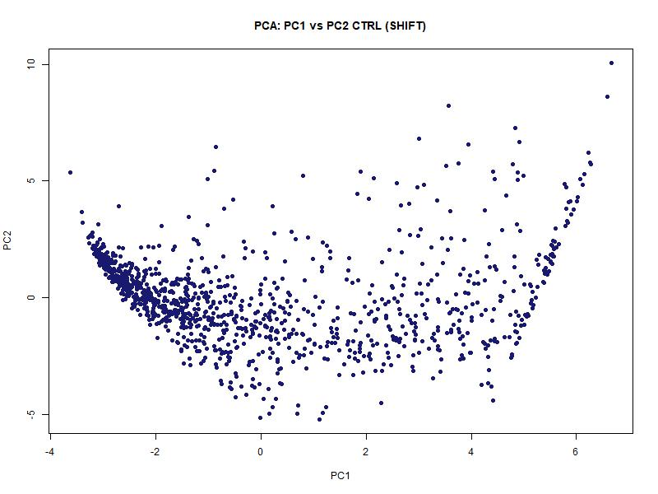
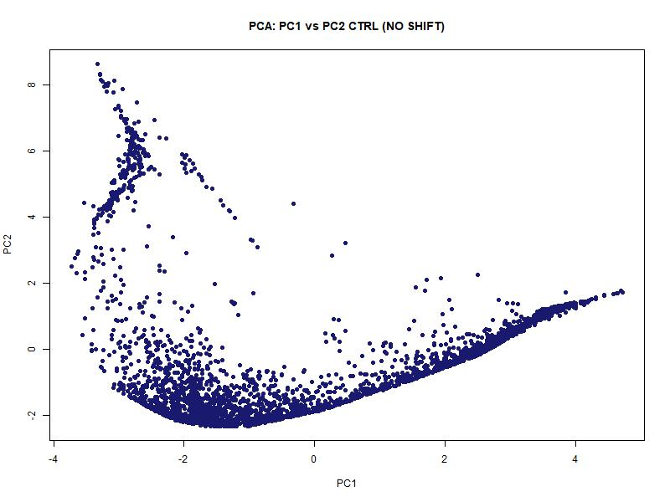
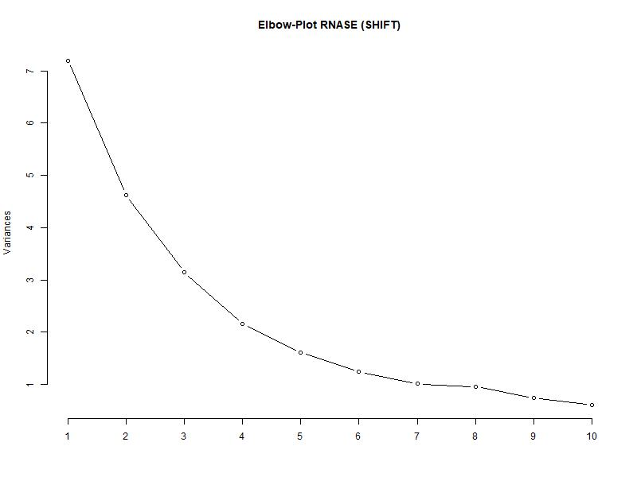
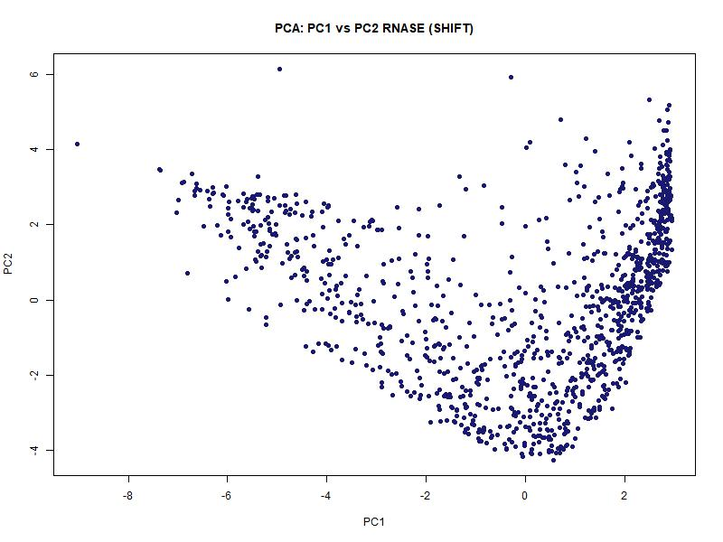
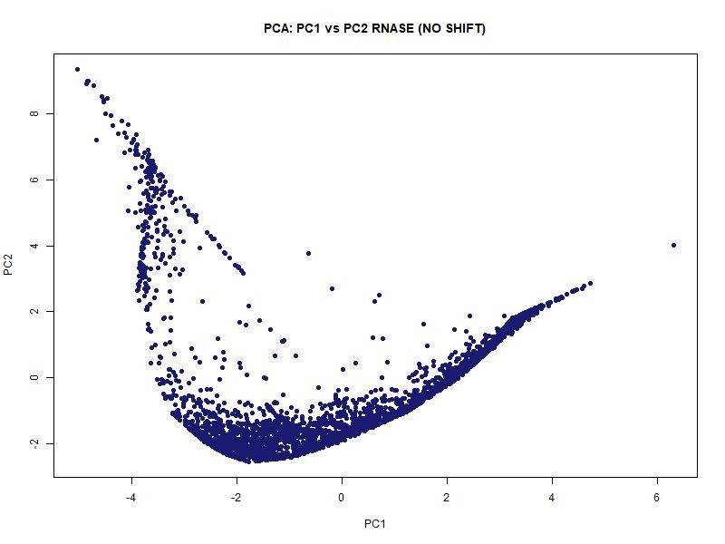
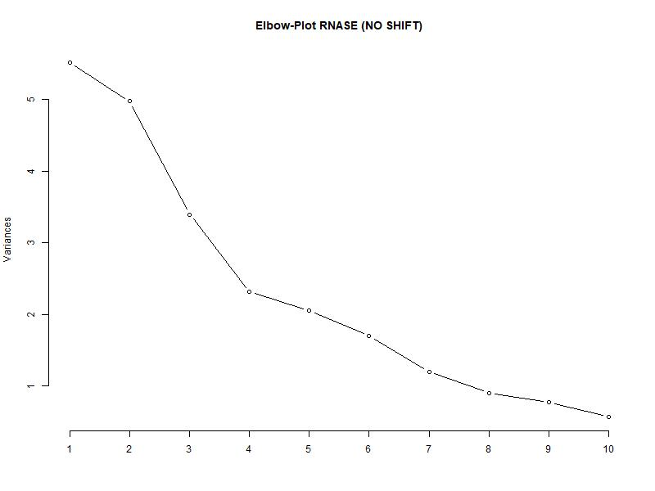
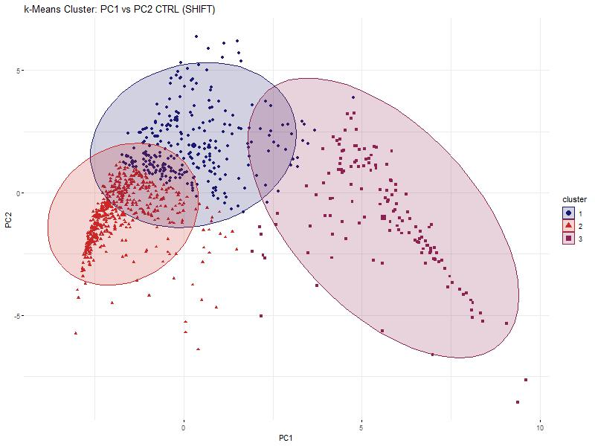
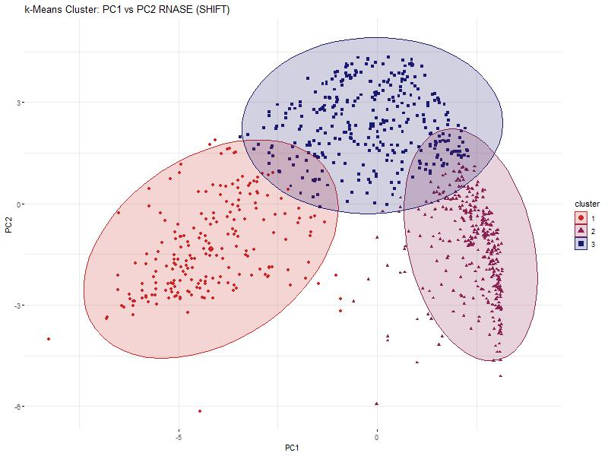
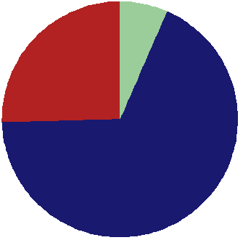
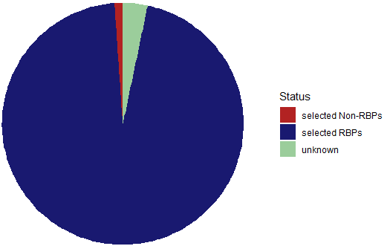
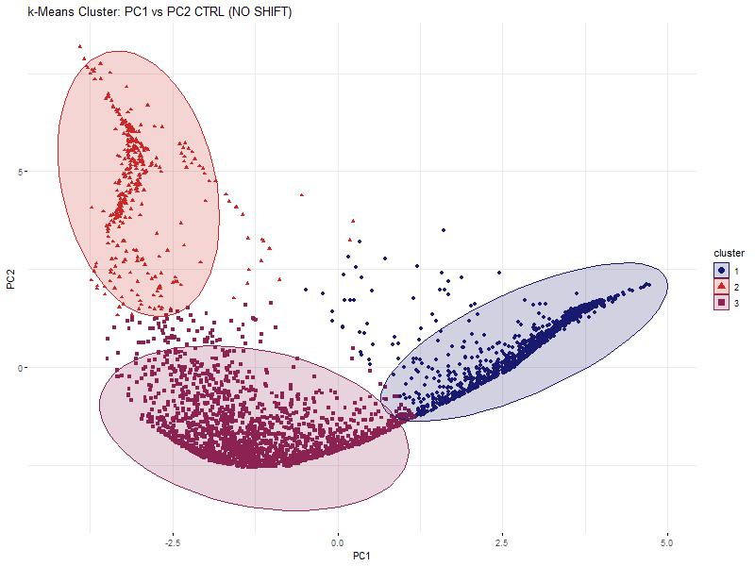
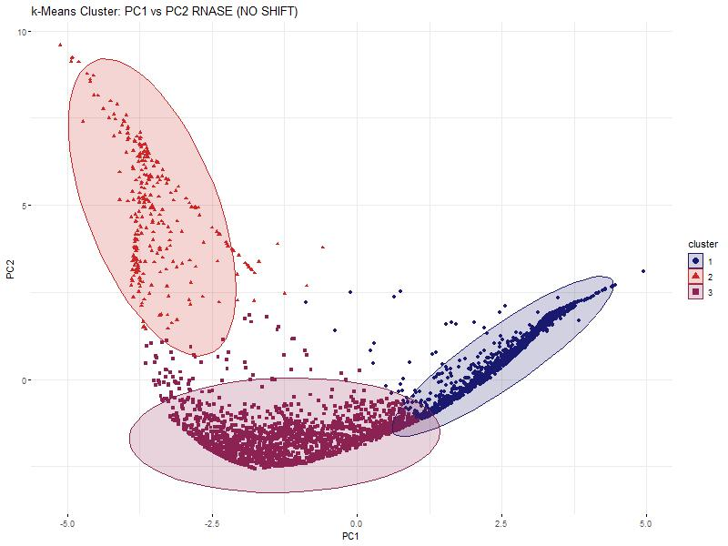

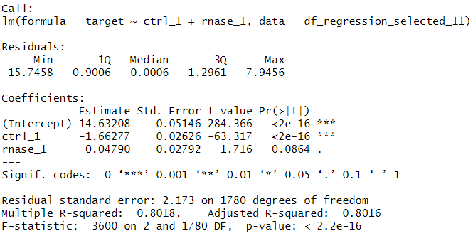
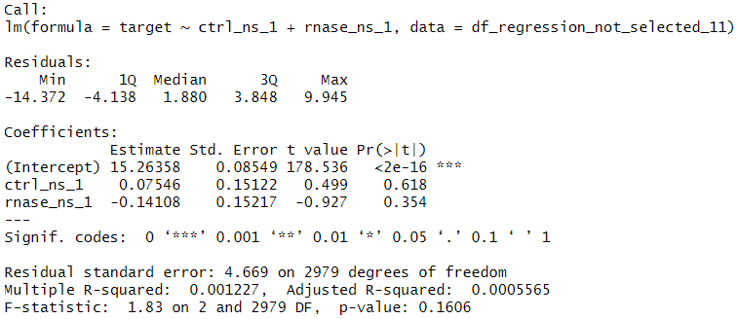

Hidden Alliances:
RNA-Dependent Protein Interactions
in non-synchronized HeLa-Cells
Baureis, J., Ferdin, J., Nicklas, B., Wintel, L.
Data Analysis Project Molecular Biotechnology SS2025
1
https://media.discordapp.net/attachments/942220665635880990/1391120974107250830/image.png?ex=686abdde&is=68696c5e&hm=aba124b02f32de4a0951fec1e1f4ec30cc92823908418468efea0b60f3d38706&=&format=webp&quality=lossless
Identifying RNA-Dependent Proteins from Proteomic Data
Why should we observe RNA.dependent proteins?
Key Regulators: RBPs control RNA metabolism & gene expression.
Disease Links: Misregulation is tied to cancer & neurodegeneration.
Functional Clues: New RBPs hint at RNA’s role in specific pathways.
Molecular Insights: Deepens the understanding of cell cycle and cellular behavior
1
2A
B
Key Characteristics of Our Dataset
Dataset was created using the R-Deep approach
Contains 4765 proteins and their intensity values under normal (control) and RNase treated conditions in 25 sucrose density fractions, each fraction measured in triplicates
Fig 1 Schematic Illustration of RNA-dependency.
A protein is considered RNA-dependent if its interactome is dependent on RNA. It is either is directly or indirectly attached to RNA, ist functionality in biological context is associated with RNA
Fig. 2 Plot of protein in data set. The data has been cleaned and normalized beforehand.
A) An RNA.dependent protein exhibits a shift for its intensity values between control and rnase group.
B) A nor RNA-dependent protein exhibits no such shift
2
Our Approach and Results
3
4A
Comparison of COM values among selected proteins
B
Comparison of COM values among not selected proteins
Fig. 4 – COM shifts between control and RNase conditions for selected and not selected proteins
Each dot represents a protein. X-axis: COM in control, Y-axis: COM in RNase. Colors match Fig. 3 and indicate subsets of selected or not selected proteins. A) Selected proteins
B) Not selected proteins
6
COM values for rnase subset
COM values for rnase subset
Frequency
COM values for control subset
COM values for control subset
Isoelectric point
6A
B
C
Fig. 6 – Histogram of isoelectric points (pI) for selected proteins The mean pI (8.16) is marked by a black line. A right-sided t-test against pI = 7.0 yielded a p-value of 2.2e-16, indicating that selected proteins have significantly higher isoelectric points.
Fig. 3 Criteria for the classification of proteins regarding RNA-dependency
Selected (RNA-dependent):
COM shift ≥ 2 fractions (orange)
or: no COM shift, but main peak shift ≥ 3 fractions and correlation < 0.7 (red)
Not selected (not RNA-dependent:
No COM shift ≥ 2 and no peak shift ≥ 3 (purple)
or: peak shift without COM shift and correlation ≥ 0.7 (dark blue)
Fig. 5 Principle Component Analyses and Elbowplots of the selected and the non-selected proteins. RNASE and CTRL are plotted separately for comparison in the PCA. The Elbowplots shows only RNASE.
A) PCA of the selected proteins. The data points of the RNASE compared to the CTRL make up an overall similar shape, but a shift is visible in the density of the points. B) PCA of the non-selected proteins. The points of the RNASE and CTRL form mostly the same structure. C) Elbow-Plot of the RNASE. The knick of the elbow is between 3 and 4. To compare selected and non-selected proteins, we decided to use 3 clusters in the kmeans clustering.
3
4
Discussion
Our Achievements
7A
B
Fig. 7 kmeans clustering of the selected and not-selected proteins
A) Shows the 3 clusters of the CTRL of the selected proteins. B) Shows the 3 clusters of the RNASE of the selected proteins. A significant shift in form and location of the clusters is noticeable. C) Shows the 3 clusters of the CTRL of the not-selected proteins. D) Shows the 3 clusters of the RNASE of the not-selected proteins. No shift in form and location is noticeable.
We found 951 different RNA dependent proteins and 3814 proteins that are not RNA dependent
Our selection criteria seem to work well for detecting RNA dependent proteins and they can be continued to be used in the future
C
D
Fig. 8 Linear regression analyses between the selected proteins and the not-selected proteins each, with global maxima of the selected CTRL proteins as target variable
A) The left regression analysis for the selected proteins describes the target variable well, the right analysis of the not-selected proteins does not. This proves, that there is a difference between the selected and not-selected proteins, and therefore, that the selection criteria worked.
5
References
8A
Sternburg et al., Global Approaches in Studying RNA-Binding Protein Interaction Networks, 2020, Trends in Biochemical Sciences.pdf
Caudron-Herger et al., R-DeeP Proteome-wide and Quantitative Identification of RNA-Dependent Proteins by Density Gradient Ultracentrifugation, 2019, Molecular Cell.pdf
Caudron-Herger et al., Identification, quantification and bioinformatic analysis of RNA-dependent proteins by RNase treatment and density gradient ultracentrifugation using R-DeeP-2020-Nature Protocols_1.pdf
Corley et al., How RNA-Binding Proteins Interact with RNA Molecules and Mechanisms, 2020, Molecular Cell.pdf
Rajagopal et al., An atlas of RNA-dependent proteins in cell division reveals the riboregulation of mitotic protein-protein interactions. Nat. Commun. 16, 2325 (2025).pdf

